Slide 1

Credit Card Fraud Detection
Zhenghao An

Slide 2
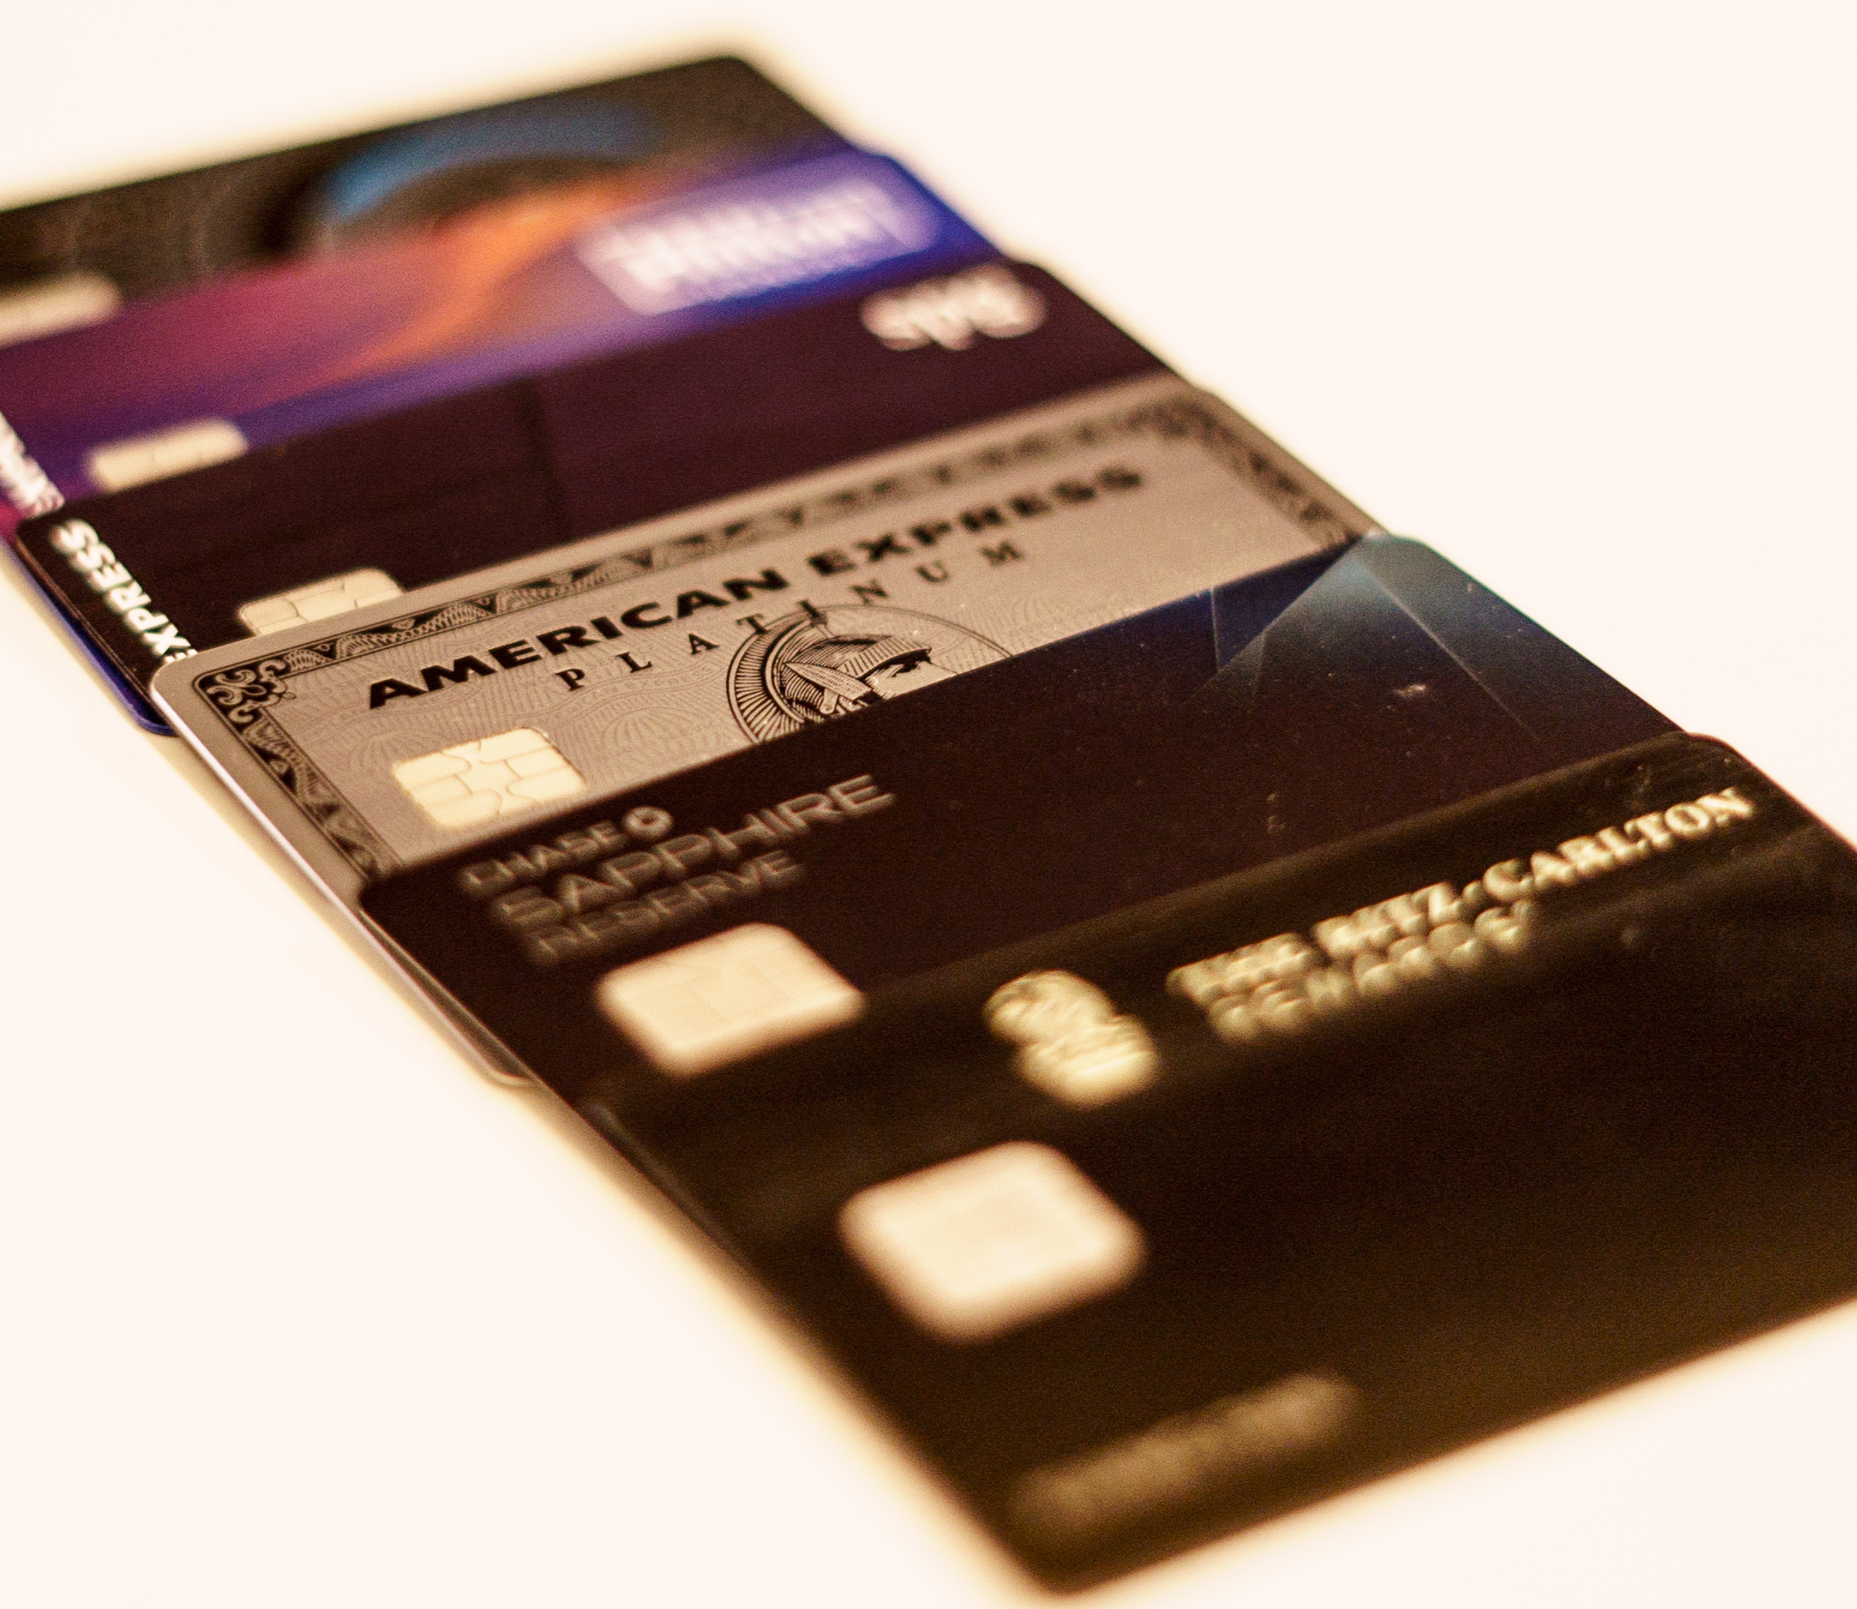
Credit Card Fraud： A Global problem
Credit card fraud is the illegal acquisition and use of another person's credit card information for the purpose of making unauthorized transactions

Slide 3

Data Source
The dataset was obtained from Kaggle by Dhanush Narayanan R.
https://www.kaggle.com/datasets/dhanushnarayananr/credit-card-fraud

Slide 4
Feature Explanation
distance_from_home - the distance from home where the transaction happened.
distance_from_last_transaction - the distance from last transaction happened.
ratio_to_median_purchase_price - Ratio of purchased price transaction to median purchase price.
repeat_retailer - Is the transaction happened from same retailer.
used_chip - Is the transaction through chip (credit card).
used_pin_number - Is the transaction happened by using PIN number.
online_order - Is the transaction an online order.
fraud - Is the transaction fraudulent.

Slide 5
Data Preprocessing Overview
Data Sampling
Data Preparation
Training and Testing Split
Feature Scaling

Slide 6

Data Sampling
To make the dataset more manageable while preserving its characteristics, a random sample of 5,000 records was extracted from the original dataset.

Slide 7

Data Preparation
The dataset was split into features (X) and the target variable (y), where 'fraud' is the target variable we aim to predict

Slide 8

Training and Testing Split
The data was then divided into training and testing sets to validate the model's performance. We used 70% of the data for training and 30% for testing.

Slide 9

Feature Scaling
To ensure that all features contribute equally to the model's performance, we standardized the features using StandardScaler.
This scaling helps in normalizing the data within a particular range and speeds up the calculations in an algorithm.

Slide 10

Machine Learning Methods
Logistics Regression
K-NN
Decision Tree
Random Forest
Linear Discriminant
Naïve Bayesian
SVM (Linear, Gaussian, Polynomial)

Slide 11
What is TPR & TNR for？
TPR is the ratio of transactions correctly identified by the model as fraudulent to the total number of actual fraudulent transactions.
TNR is the ratio of transactions correctly identified by the model as non-fraudulent to the total number of actual non-fraudulent transactions.

Slide 12
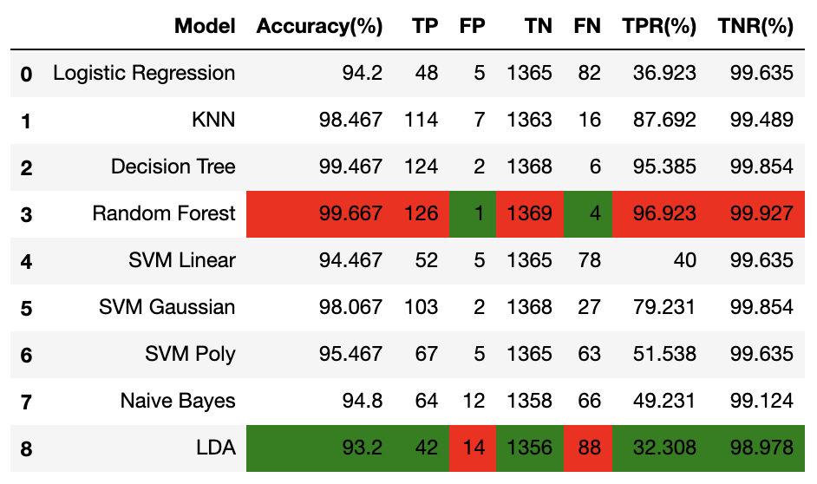
Model performance table
Red represents the highest value
Green represents the lowest value

Slide 13
Model performance table
Random Forest has the highest accuracy with the highest TPR and TNR.
LDA (Linear Discriminant) has the lowest accuracy with the lowest TPR and TNR.

Slide 14
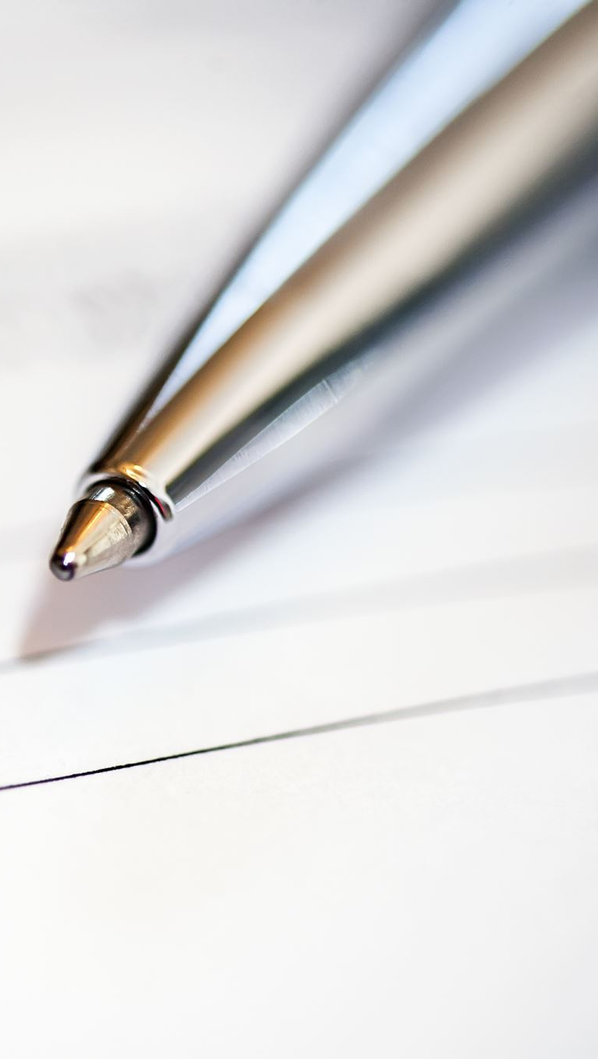
Conclusion
Random forests and decision trees performed best in this analysis, particularly in terms of accuracy, true case rate (TPR), and true negative case rate (TNR).
Logistic regression and LDA, while decent in overall accuracy, fall short in the more critical fraud detection (TPR)

Slide 15
Why?
Handling Imbalanced Data: Random Forest is better equipped to handle imbalanced datasets. It can still produce reliable predictions even when the fraudulent class is much smaller than the non-fraudulent class.
Bias towards Majority Class: LDA, being a linear classifier, may struggle with highly imbalanced data, often becoming biased towards the majority class (non-fraudulent transactions). This can lead to a high number of false negatives, where fraudulent transactions are incorrectly classified as legitimate.

Slide 16
Thank You！

